Slide 1
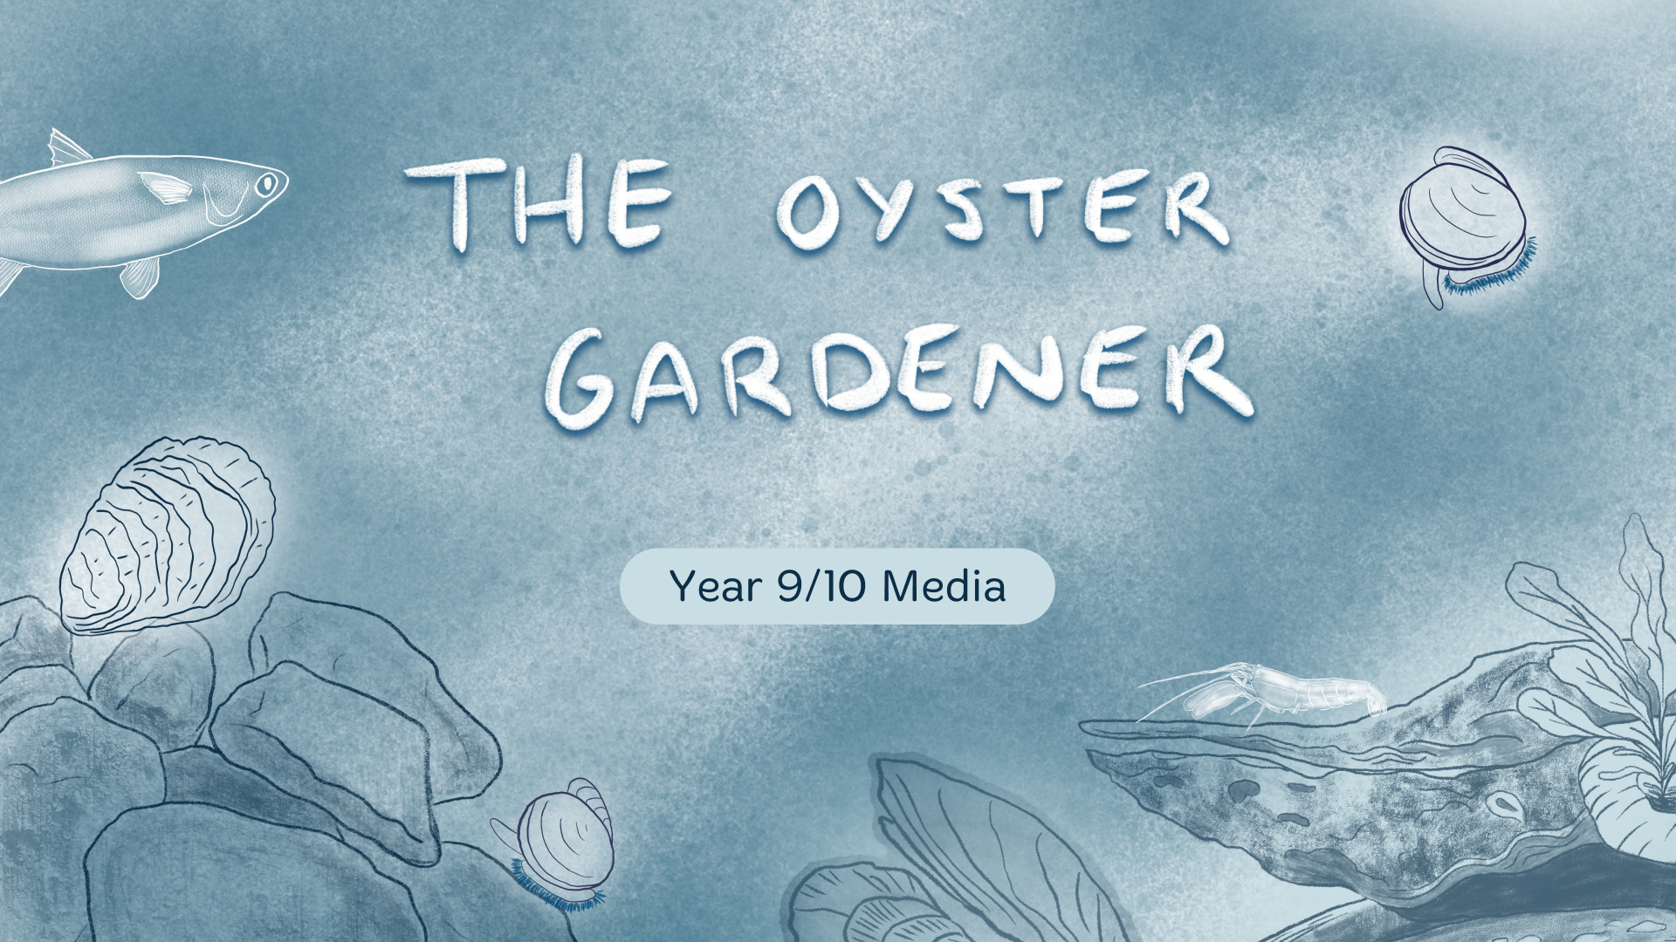

Slide 2

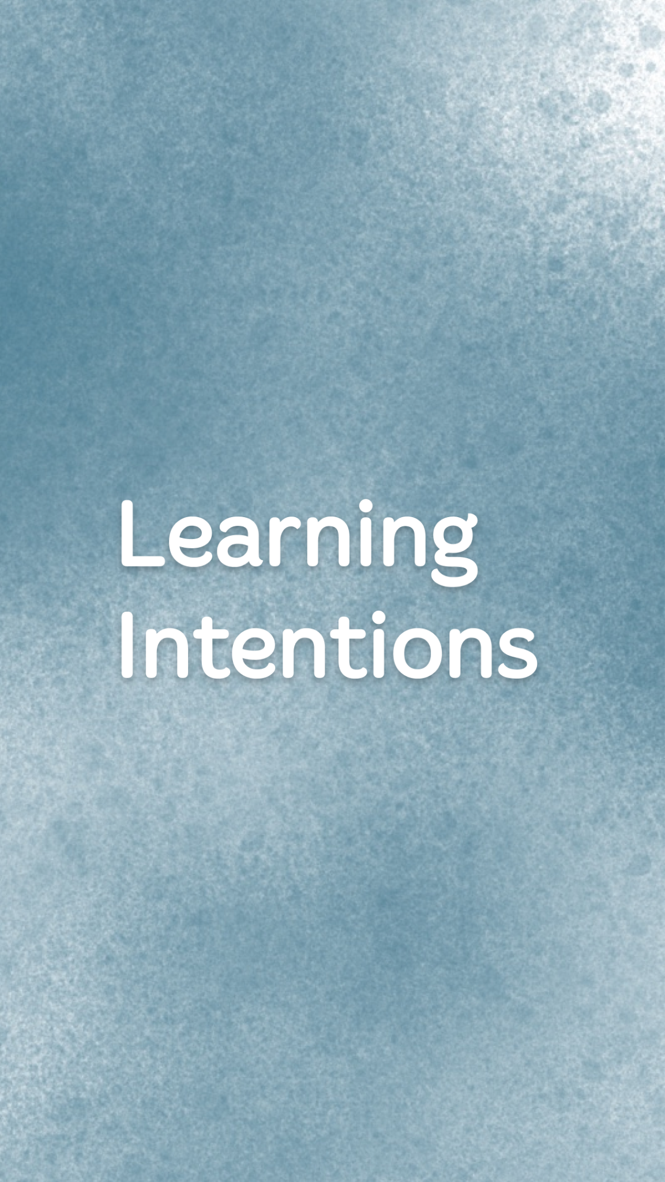
To understand how codes and conventions are used in The Oyster Gardener, local environmental issues in your area, and how to plan and produce an informative production about it.

Slide 3


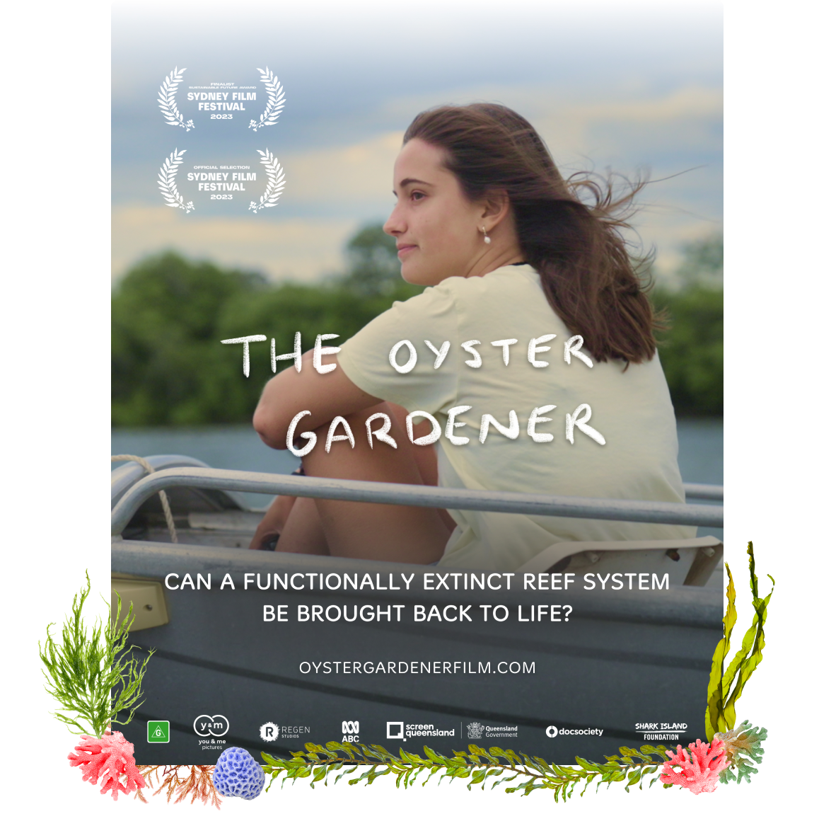
What can you infer about the film from the poster?
What does the setting tell you?
What does the font imply?
What does the text tell you?
What themes might be present?

Slide 4

The Oyster Gardener lived its ethos of sustainability.
At all stages of production, sustainability was at the forefront for the creators.
Using a carbon calculator (Sustainable Screens Australia and BAFTA albert), producers Julia Lörsch & Kim Ingles were able to input all of their data and figure out what the carbon footprint of the film would be.
By doing so, they were able to look at all the areas in which they could reduce their environmental impact.

Slide 5

The film was produced by You and Me Pictures in association with Regen Studios.
The Oyster Gardener was predominantly funded by Screen Queensland for approximately $18,000. Regen Studios also supported the film with funding from Shark Island Institute.
ABC and Doc Society worked together to provide several production teams with a distribution channel, funding and mentoring, for a number of short Australian documentaries - the ‘Your Planet’ program - that profiled stories about environmental and climate solutions.
Find out more about the ‘Your Planet’ documentary initiative.
Pre-production for The Oyster Gardener began on August 25th, 2022 and production commenced from November 7th 2022.

Slide 6

The Oyster Gardener was shot in Queensland in Dec 2022 and Jan 2023.
A key feature of the film was sustainability, and the producers went into a lot of detail to ensure they remained as remained as low carbon/ low emission as possible. This included looking at what would be highest usage of emissions for productions - which was cars for both talent and crew, boat hire and fuel, followed by electricity.

Slide 7
During production, these were some of the practices they put in place that helped them keep the production’s footprint low:
  By planning and distributing the film digitally including having remote meetings with EPs / partners (ABC and Regen Studios) to minimise travel
  Vegetarian catering on set
  Cast and crew brought their own refillable drink bottles to set
  Carpooling with cast and crew to get to set
  Ensuring all batteries used are rechargeable
  Eating at cafes meant no waste and take away packaging.

Slide 8

As with the rest of production, post was no exception to the sustainability ethos and this was accounted for in the calculator.
Colour grading and sound mixing was done remotely, working with providers in other parts of the country who were able to facilitate a remove reviewing process meant
that no travel was required.
An additional, pick-up shoot in Tasmania was arrange for a local filmmaker, which meant that crew from the Sunshine Coast didn’t have to travel. A bonus is that Tasmanian power has less GWP (mostly hydro).
A large portion of the footprint for post production was the energy use from edit suites.

Slide 9

The Oyster Gardener premiered at the Sydney Film Festival (SFF) on June 8th 2023, and was shortlisted for the SFF’s Sustainable Future Award.
It became available to stream on ABC iView from Saturday 17 June, 2023.
It was broadcast on ABC after Landline on Saturday 29 July at 4:20pm.
The film is available on ClickView for Australian schools to access.

Slide 10

A documentary film is a film which concerns factual topics and information about the real world.
‘Documentary conventions’ are elements that you expect to see when you watch a documentary.
Think about documentaries you have seen – what elements did you see across them all? This can include mockumentaries, which also use these elements but for comedic purposes.

Slide 11

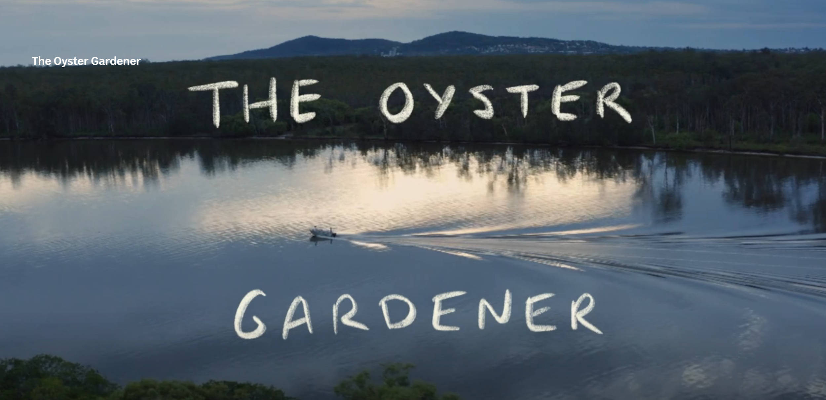
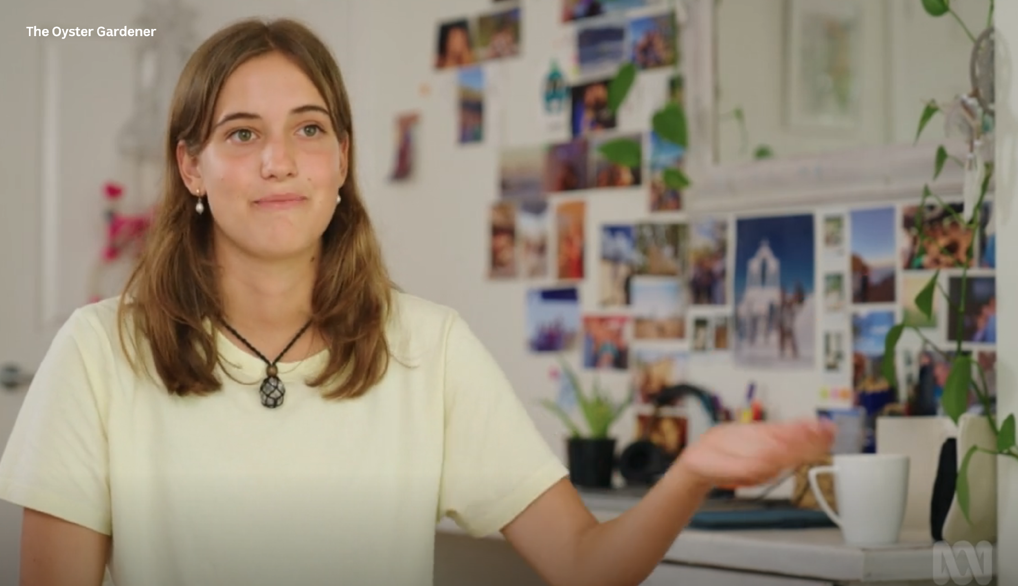
Some examples of documentary conventions
include:
Use of voice-overs
Interviews (direct and indirect)
Subtle editing
Archival footage and photographs
Use of real people
Exposition
Use of text and titles
Montage

Slide 12


Who is the protagonist in the film? What is her aim?
What are three documentary conventions used in the film?
What different kinds of camera angles and shot types are used?
What mood does the non-diegetic sound evoke in audiences?
Describe the plot in terms of the Three Action Structure - what is established, what happens in the development of what is the resolution of the narrative?
What information does the mise en scene convey to audiences? (look at clothes, time of day, setting, lighting, props etc.)
Why do you think animations were added into the film?

Slide 13

What is a social impact campaign?
Documentaries have a unique power to inspire change.
An impact campaign takes a documentary and creates a strategy from it, defining what kind of impact the documentary can achieve and seeking measurable results. It is about thinking about your film as a tool for social change and putting a plan in place for how you will reach the right audiences, who you can partner with and how you distribute the film, how you can create more engagement with the film and what you will ask your audience to do after seeing the film.
It’s about using the power of storytelling to its maximum potential.
What does an Impact Producer do?
An impact producer is responsible for designing and implementing strategic impact and education strategies around social impact documentaries. Larger projects may have a whole impact team on them.

Slide 14

Impact Vision Statement: Young people are empowered to connect with their local environment and transform climate anxiety into grounded, active hope by learning about and contributing to caring for their local waterways.
Impact goals:
Inspire young people to find their agency and motivation to create change in their own communities through local ecosystem restoration efforts
Help alleviate climate anxiety by showcasing solutions and providing pathways for young people to take meaningful action in their own community
Enable and empower teachers and educators to host screenings of the film and utilise the educational materials to support classroom learning, and facilitate conversations with young people, about solutions to the climate crisis and biodiversity loss, and the value of getting involved in local, collective action (and the power of storytelling)
Motivate more environmental organisations to create citizen science programs that engage young people as citizen scientists, volunteers, traineeships and work placements.

Slide 15

Your turn! Pretend you are an Impact Producer for the The Oyster Gardener.
Choose 2 of the impact goals from the previous slide and brainstorm all the ways that you could achieve impact with the film to reach those goals. Include ideas for organisations you could partner with, resources you could create, and special opportunities to enable your target audience to see and engage with the film.
For example, if you chose number 4, you could come up with some ideas to host screenings for various environmental organisations and NGOs. Are there any special International or National days (ie. World Ocean Day) or conferences/summits you can find, that you could tie a screening to? Are there any events or groups locally that you would approach and connect with for a screening and also to discover how you could get involved with volunteering ongoing yourself.
Tip: Check out the Impact Field Guide and Toolkit to find case studies and examples of how other impact films have reach and inspired their audience: https://impactguide.org/library/
Notes:
Extension Task

Slide 16

Research Task: Using local environmental organisations, council websites, conservation groups, or government agencies – find their environmental or sustainability pages.
What are some environmental issues in your local area? What is being done to help?
Make a list of at least 3 issues in your local area and write a short summary of the issue, what is being done already, and how people can further help.
With a partner or small group, choose one issue from your list to base your production work on.
You are now going to create an online advertising campaign, a short (5 minute) documentary or podcast or a series of print ads/billboards about this issue and what people can do to help/support it.
Your target audience is teenagers and young adults in your local area.

Slide 17

What are the primary sources of water in your local area, and how are they being managed?
What are the main challenges or threats to water resources in your community?
Are there any specific environmental issues or concerns related to water quality or pollution in your region?
What initiatives or projects are currently underway to promote water conservation and sustainability?
How do local government policies and regulations address water conservation and environmental protection?
Are there any community-based efforts or grassroots initiatives focused on water or environmental conservation?
What role do industries, agriculture, and urban development play in affecting local water resources and ecosystems?
How do climate change and weather patterns impact water availability and management in your area?
Are there any success stories or best practices from neighbouring communities or regions that we can learn from?
How can individuals, schools, and community organisations contribute to efforts aimed at improving water conservation and sustainability locally?

Slide 18

Using your research, you are now going to create an informative media production – either an online campaign, a short documentary, a short podcast, or a series of print advertisements/billboards for local exhibition to help raise awareness about the issue or about what people can do to help.
For the documentary, complete a script and storyboards.
For the podcast, complete a script and mock up of the image for the cover.
Online campaign – choose your platform/s. If creating video content, complete script/storyboards. Any still images or graphics, complete mock up images.
Print ads/billboards – complete mock ups and decide where they would be shown around the community. Find locations and mark on Maps.

Slide 19

How will you distribute your production? Films, podcasts, and online campaigns should be distributed online in places that it will reach your teenage/young adult audience.
For the print campaign, print off your posters/ads and put them up around your school (as a starting point).

Slide 20

You will have X amount of classes to complete the production/post-production. You may need to take photographs/film outside of school to get images or footage of relevant areas/people.
Film interviews with experts, community members, or people involved in water conservation efforts.
Capture footage of relevant locations, such as water treatment facilities, natural water bodies, urban areas, and agricultural regions.
Use a variety of filming or photography techniques to enhance visual appeal and convey key messages effectively.
Record voice overs, narration, and ambient sounds to complement the visual content.

Slide 21

Upon completion of your production, each member should individually complete a reflection based on the following:
Discuss the process of creating your documentary, considering challenges faced, lessons learned, and insights gained.
Discuss the effectiveness of your production in conveying messages about water conservation and sustainability.
Identify opportunities for further exploration or improvement in future media productions.

